Slide 1
Automated Detection of Mental Disorder From Text Using Natural Language Processing
Supervised by: Dr.Amr Ghoneim
Done by:Mariam Yasser

Slide 2
TABLE OF CONTENTS
01
04
02
05
03
06
Related Works
Feature extraction and Models
Related Works
And Dataset
Results and Testing
Pre-Processing
CONCLUSIONS

Slide 3
INTRODUCTION
People share every single detail of their life on social media
Stress is the main symptom in most of mental disorders.
Exploiting oversharing on social media will give a good impact on people’s mental health.
This is aiding doctors and psychiatrists in detecting stress.

Slide 4
Main Objective
Enhance Detecting stress in early stages from posts on social media.
Using NLP for preprocessing.
Using 4 machine learning models.
Using 1 deep learning model.

Slide 5
01
Related WORKS

Slide 6
Related Works
According to Shaunak Inamadar, March 2023.
Models | TF-IDF | Word2Vec
Naïve Bayes | 0.89% | 0.91%
SVM | 0.94% | 0.91%
XGBoost | 0.76% | 0.72%
LR | 0.79% | 0.80%

Slide 7
02
Dataset

Slide 8
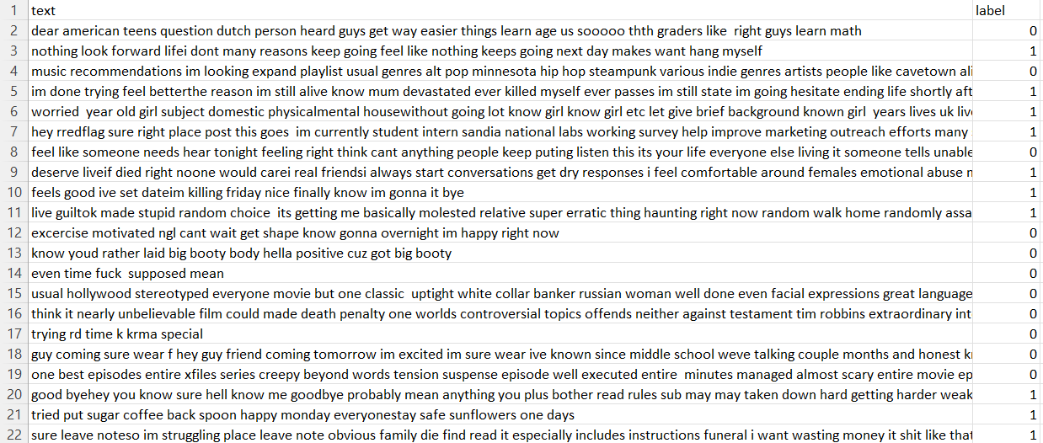
Dataset
Dataset used is called”Mental_Health”, have mainly 28,000
Consisit of two columns:text and label
Text collected from reddit posts on social media
Labels are 0 and 1, 0 is indicator for “Not stressed” and 1 is indicator for “stressed”

Slide 9
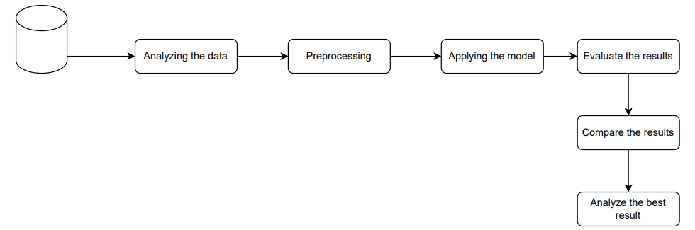
Proposed Solution

Slide 10
03
Pre-Processing

Slide 11
Pre-Processing Steps
Lowercaasing
Lemmatization
1
4
Removing URLS and punctuations
Stemming
2
5
Stop words
Tokenization
3
6

Slide 12
04
Feature extraction and Models

Slide 13
What is TF-IDF?
Feature Extraction
TF-IDF vectorization to the training and testing data.
It uses the words values to transform the raw text input into a numerical representation.
vectors can be used for various text analysis tasks.

Slide 14
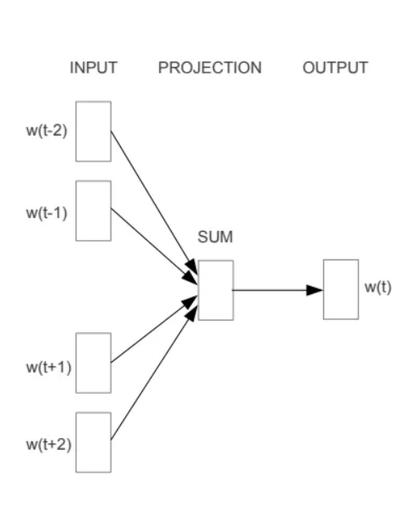
What is Word2Vec?
Feature Extraction
It is based on the notion that words with similar meanings frequently appear in similar contexts.
It can learn the embeddings.
The model predicts the target word based on its context.

Slide 15
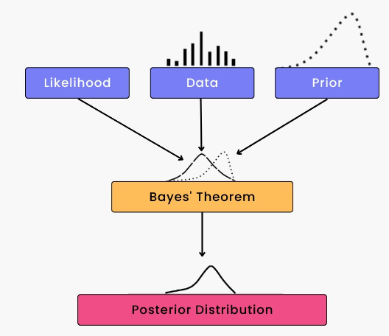
1.Naïve Bayes
Models
Effectively handle datasets with text features makes it essential for stress detection
Naive Bayes determines the conditional probabilities of each feature in the training data for each class
Applies Bayes' theorem.
Chooses the class with the highest probability as the projected class

Slide 16
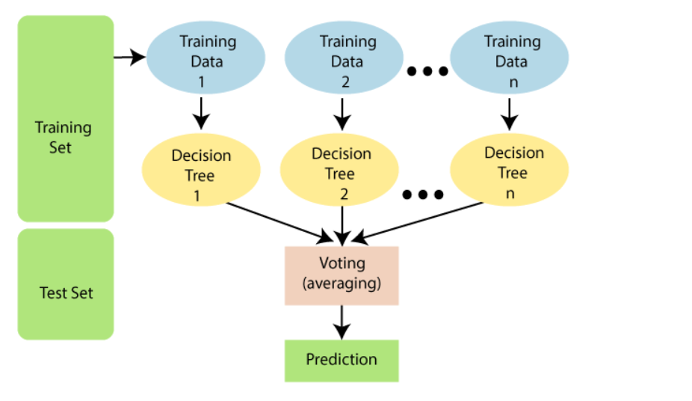
2.Random Forest
Models
Random Forest is a valuable tool for identifying project stress due to its capacity for managing complex interactions, robustness against overfitting.
It combines the predictions of various decision trees
It can handle the data set containing continuous variables.
A random subset of the training data is used to construct each decision tree in the random forest, and the forecasts of all the trees are combined to provide the final prediction.

Slide 17
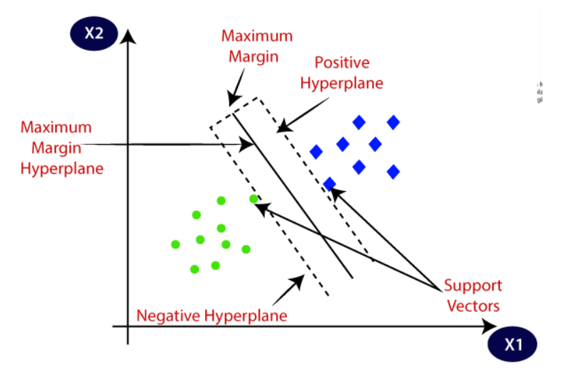
3.SVM
Models
SVM main use is the solution of binary classification issues.
Finding the optimum hyperplane that separates the data points of distinct classes
Understanding the context and patterns in a textual material is frequently necessary for stress detection.

Slide 18
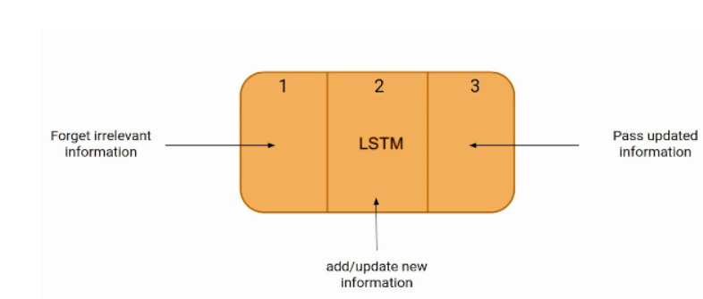
4.LSTM
Models
Long Short-Term Memory (LSTM), is a recurrent neural network (RNN) architecture.
Data can be efficiently captured by LSTM .
The gates regulate the information flow
Contains memory cells and 3 gates(Forget gate, Input gate, Output gate)

Slide 19
05
Results and Testing

Slide 20
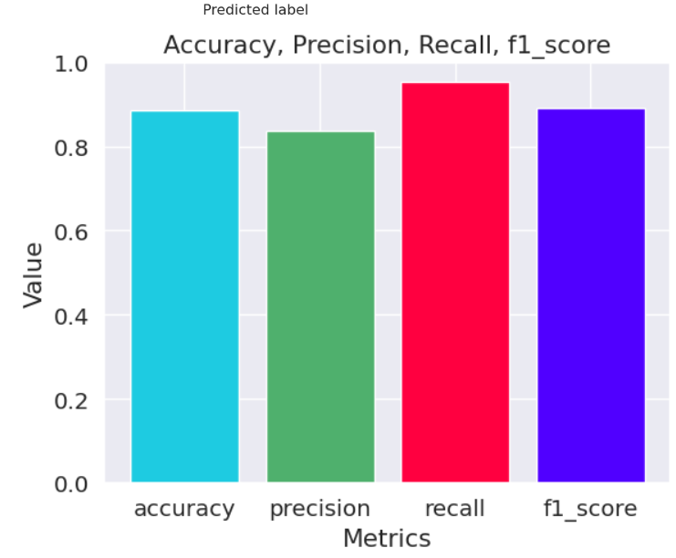
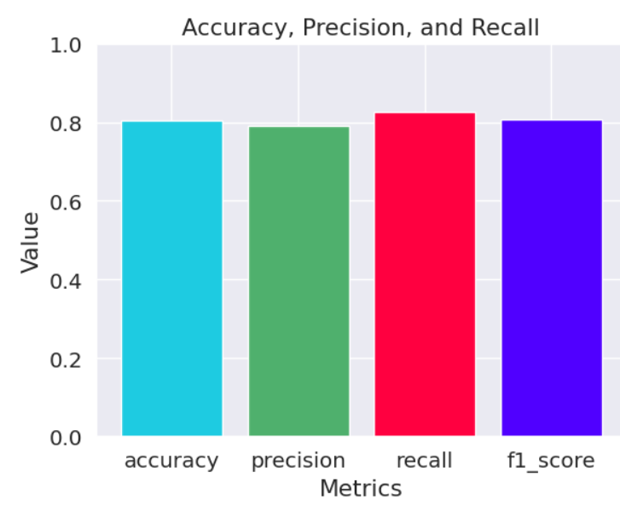
Naïve Bayes
TF-IDF
Accuracy:0.88% Precision:0.84% Recall:0.95% F1:0.88%
Word2Vec
Accuracy:0.81% Precision:0.79% Recall:0.83% F1:0.81%

Slide 21
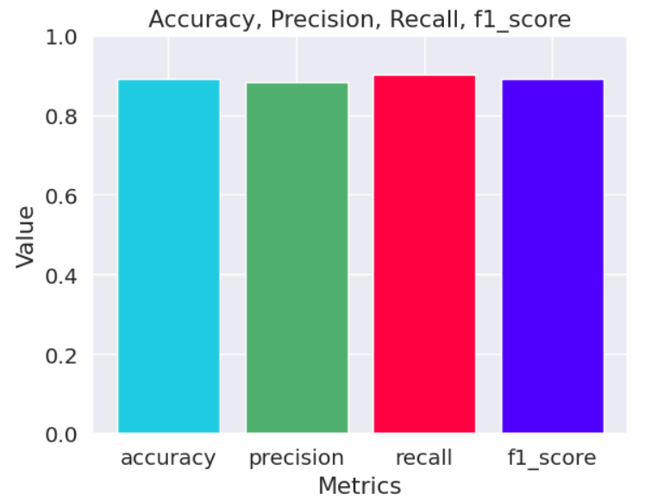
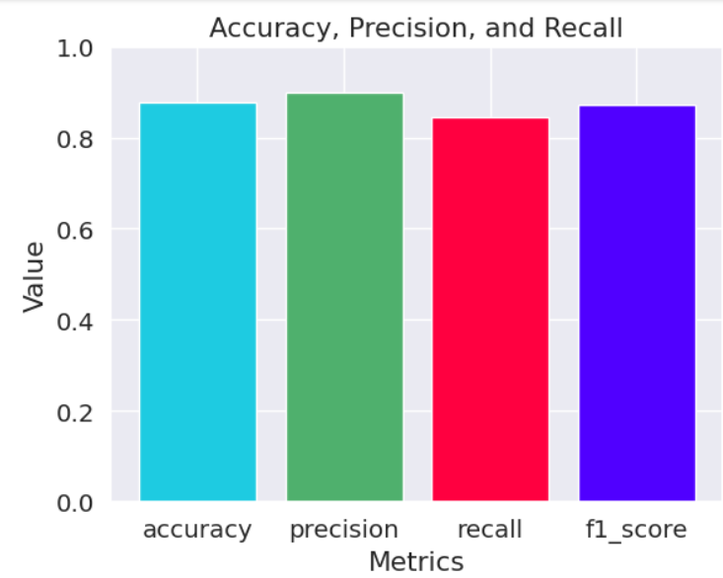
Random Forest
TF-IDF
Accuracy:0.89% Precision:0.88% Recall:0.90% F1:0.89%
Word2Vec
Accuracy:0.88% Precision:0.89% Recall:0.84% F1:0.87%

Slide 22
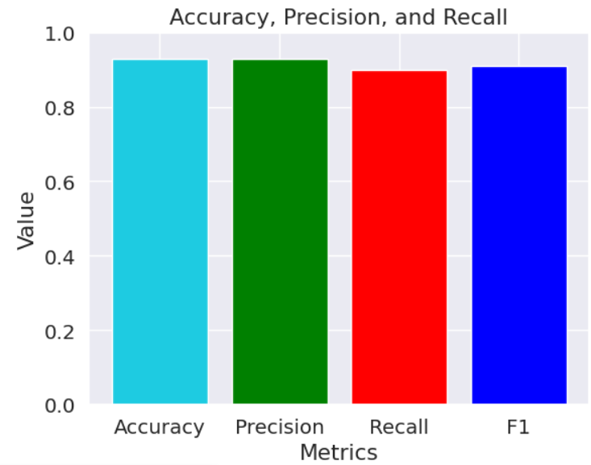
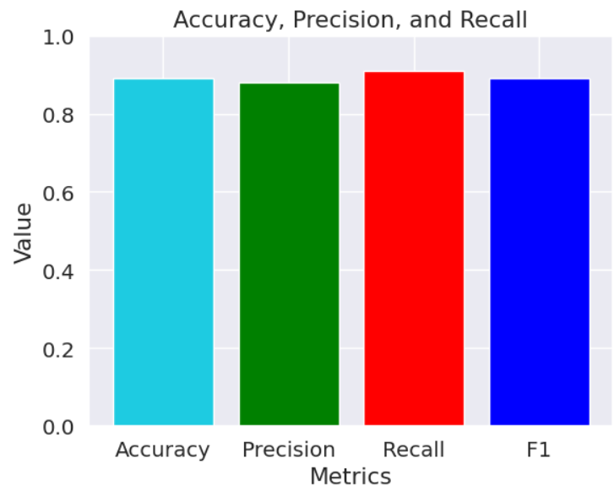
SVM
TF-IDF
Accuracy:0.93% Precision:0.90% Recall:0.86% F1:0.88%
Word2Vec
Accuracy:0.89% Precision:0.88% Recall:0.91% F1:0.89%

Slide 23
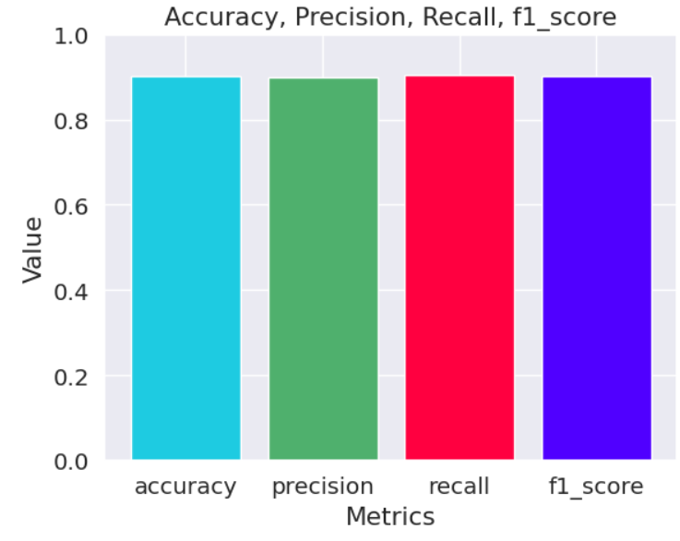
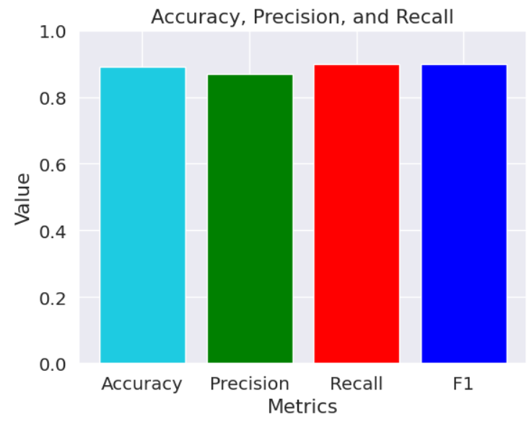
LSTM
TF-IDF
Accuracy:0.90% Precision:0.90% Recall:0.89% F1:0.90%
Word2Vec
Accuracy:0.89% Precision:0.87% Recall:0.90% F1:0.90%

Slide 24
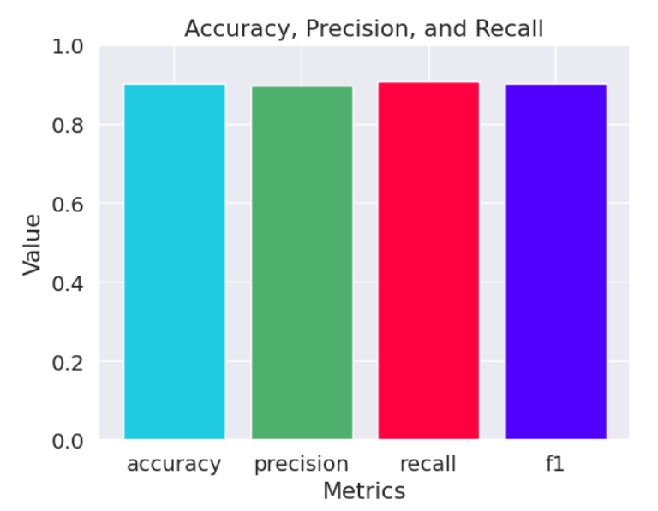
Four Models Ensemble
Ensemble got accuracy 90 for Word2Vec and 65% for TFF-IDF.
By combining predictions from multiple models, ensemble methods can reduce bias and variance, leading to more reliable and robust predictions.
Each model in the ensemble may have different strengths and weaknesses, and combining them helps to capture a broader range of patterns and make more accurate predictions on new, unseen instances
Ensemble methods can help mitigate overfitting

Slide 25
06
Conclusion

Slide 26
CONCLUSION
In this study demonstrates the potential of NLP and machine learning
models for detecting stress.
The application of all the models revealed that SVM outperformed the other models.
The ability to perform this project could provide valuable insights into population-level mental health trends.
However, it is important to note that this study has its limitations.

Slide 27
Any Questions?

Slide 28
Thank You!

